Slide 1


Slide 2
“CLOSE THE CARE GAP”
WORLD CANCER DAY
February-4, 2023
Mr Narayan Prasad Chaudhary
Sr Public Health Officer
Health Officer Rukum East

Slide 3
Cancer Facts
Preventable disease with either vaccine or behavioural and life style changes
Curable disease if detected in early stages
Some advanced stages too can be cured with treatment
Some government schemes for treatment of cancer

Slide 4
Cancer Myths
I have no family history of cancer, so I won’t get cancer.
Does not mean that if you have no family history of cancer you won’t get the disease
Genetic mutations can be random, caused by environmental factors such as radiation exposure and pollution, and lifestyle factors such as smoking, obesity, excessive drinking, and poor dietary habits

Slide 5
Cancer Myths
All lumps are cancer
Majority of lumps that are detected during screenings and medical examinations are benign or another condition entirely such as a cyst. A doctor will conduct tests to determine if a growth is benign or cancerous.

Slide 6
Cancer Myths
Cancer is always fatal.
Early diagnosis and detection greatly improve the survival rate
Cancer is contagious.
Cancer can spread within the body, it cannot be transmitted from one person to another

Slide 7
Common cancer in Nepal and associated risk Factors
Cancer | Risk factors
Lung Cancer | Smoking such as cigarettes, bidi, hookha.
Cervical cancer | Smoking, HPV infection, multiple sexual partner of spouses, smoking.
Breast Cancer | Smoking, alcohol, nulliparous, physical inactivity, Genetic.
Colorectal cancer | Smoking,alcohol,overweight and obesity, low fibre high fat diets, Genetic.
Head and neck cancer(oral cavity and throat) | Tobacco and tobacco related products, alcohol, infection(HPV).

Slide 8
Cancer Screening and Early Detection
Cervical cancer:
Screening strategy for cervical cancer includes:
1) Pap’s Smear/cytology based screening
2)Visual Inspection with Acetic Acid(VIA)
3)High Risk Human Pappiloma Virus Testing (hrHPV)
Women aged 30-60 years need to get screened every 5 years.

Slide 9
Cancer Screening and Early Detection
Breast Cancer
-Early detection is the key
-Self Breast Examination and Clinical Breast Examination help in identifying lumps.
-Remember “Not all lumps in breast are cancer”
-Learn the steps of self breast examination in nearby health center
- Report newly appearing lumps to your nearby clinical care provider.

Slide 10
Cancer Screening and Early Detection
Head and Neck Cancer
- Early detection is the key.
-Those having risk factors of using tobacco and tobacco related products need to undergo oral cavity examination on regular basis
-Report in nearby center if oral sores, difficulty in swallowing, newly appearing hoarseness of voice or newly appearing neck nodes.

Slide 11
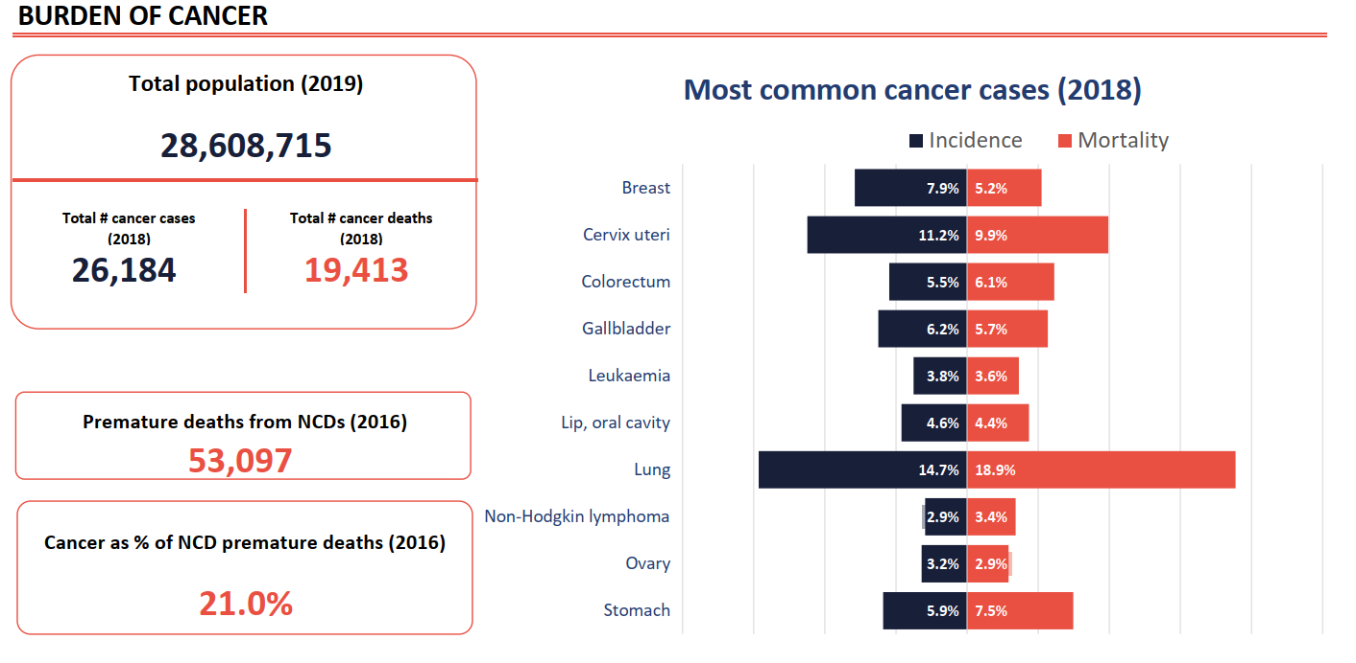
Cancer Country Profile 2020

Slide 12
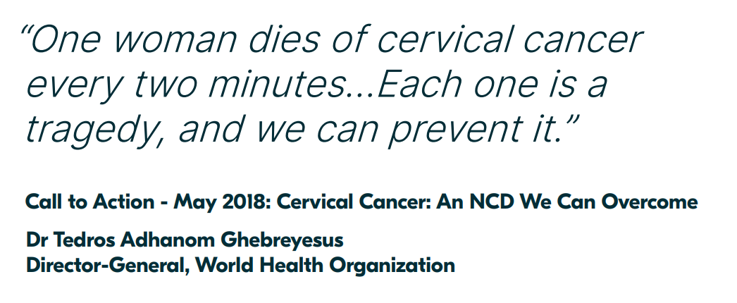
Source: Global Strategy to acceletrate the elimination of cervical cancer as a public health problem - WHO

Slide 13
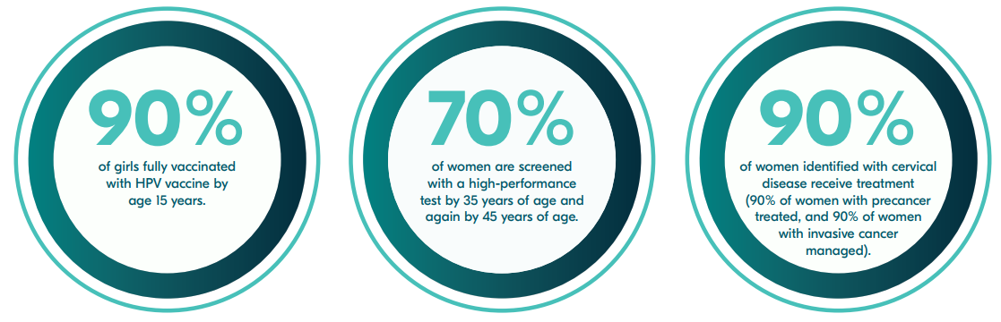
This global strategy to eliminate cervical cancer proposes
Source: Global Strategy to acceletrate the elimination of cervical cancer as a public health problem - WHO

Slide 14
Cancer program in Nepal
Population-based cancer registry (PBCR) in January 2018
Social Security fund for Cancer patients
Fund generated from excise taxes for Cancer prevention and treatment
Tobacco Prevention and control Act
Cancer Screening program in Nepal
( eg VIA, BSE, Mamography, H.pylori etc)
Notes:
VIA= Visual Inspection of Acetic Acid
BSE= Breast Self Examination
Helico bactor Pylori

Slide 15
Remember
Cancer is preventable.
Cancer is curable.
Screening and Early detection are important in identifying cancer in early stages.
Risk factor elimination and behavioural change is important in control of cancer.

Slide 16
Thank you for your kind attention !

