Slide 2
“CLOSE THE CARE GAP” WORLD CANCER DAY February-4, 2023
Nim Prasad Giri
Lab Technician
Health Officer Rukum East

Slide 5
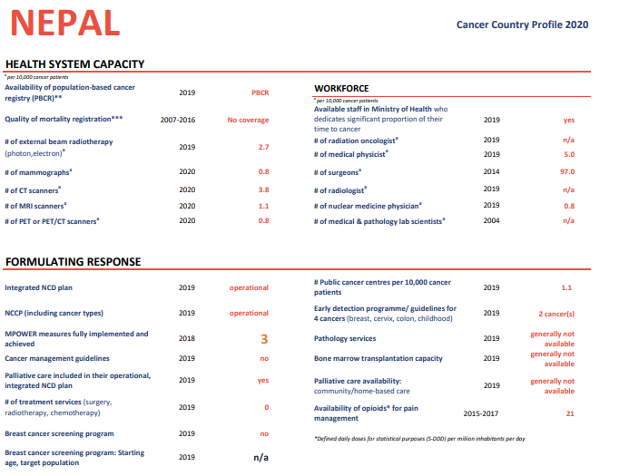

Slide 21
Thank you for your kind Attention

